Slide 1
BASIC COMPUTER USAGE
Motherboard &
CPU

Slide 2

OBJECTIVES FOR TODAY
What is Motherboard
Components that connected to Motherboard
What is CPU?
How does CPU work?

Slide 3



EXPLORE
WHAT IS …?
5 MIN
Mother | Main Board
Power supply
Processor
SSD

Slide 4
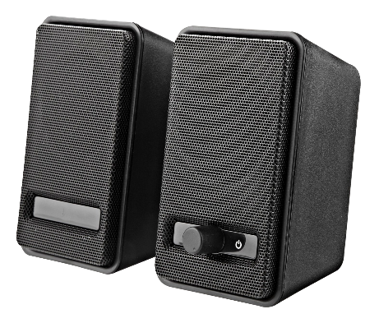
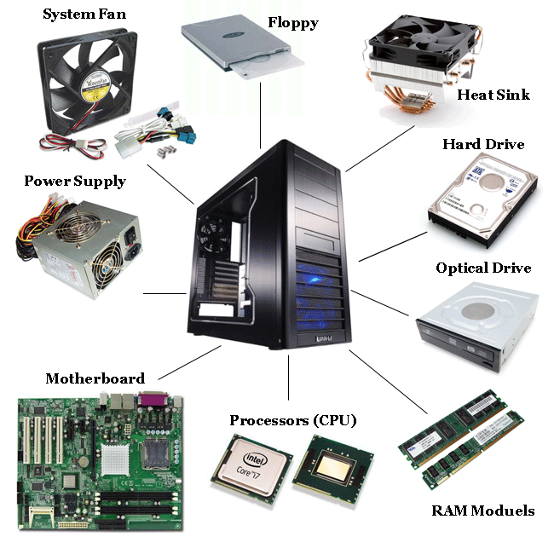

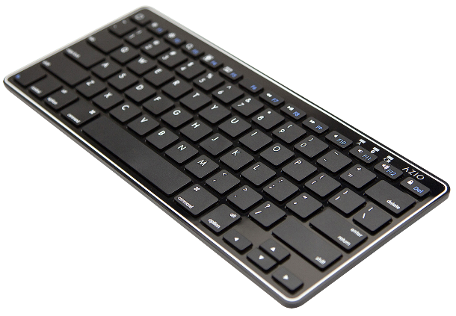
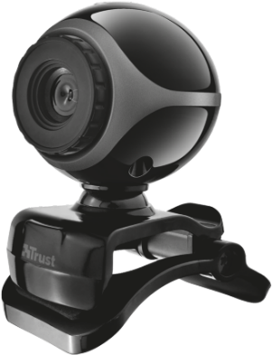

Computer Hardware
Speaker
Monitor
Keyboard
Webcam
Mouse
Notes:
Floppy disk used as a flash for storage 1MB to 2MB only
Optical Drive the same or CD Rom, DVD rom
Ram module and Ram chip
Case fan or system fan

Slide 5
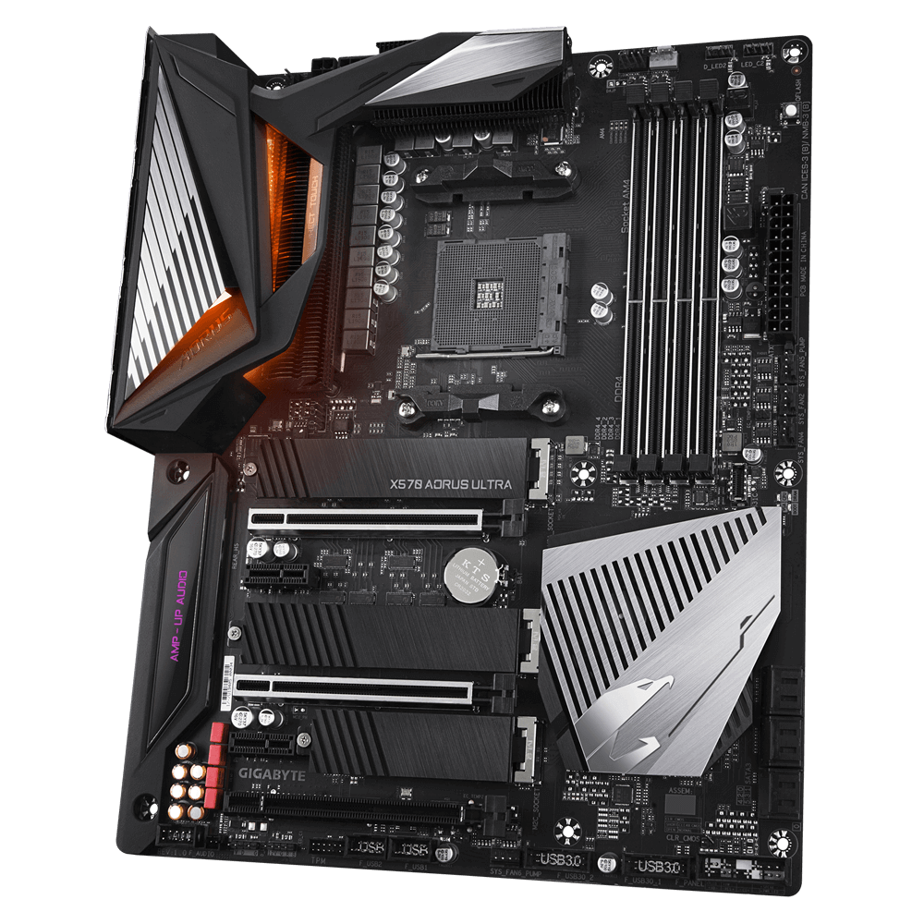
Motherboard

Slide 6

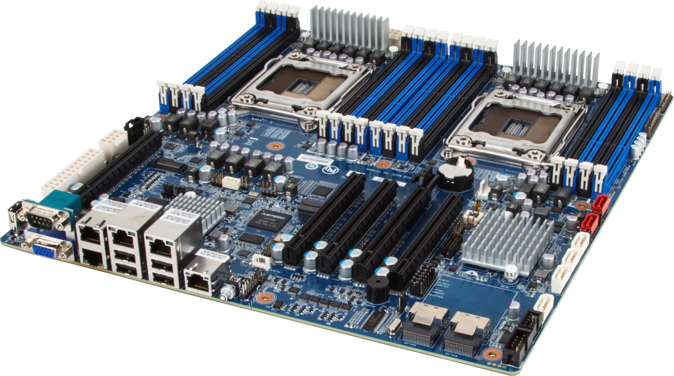
What is Motherboard?
EXPLAIN
10 MIN
The motherboard is the most important part of a PC that enables the integration and control of all other components and devices in a complete computer system.
Motherboard or Mainboard or System Board.
Notes:
Teacher can bring the broken motherboards (can ask from IT admin) to let student see what it look like.
All hardware of computer must be connected to a Mainboard.
Enables Integration(connect) and control

Slide 7

Motherboard in short
EXPLAIN
10 MIN
Motherboard is a Circuit Board
It’s a Backbone of the computer
It integrates all Hardware into one system
Allow all components to receive power and communicate together
Notes:
Teacher can bring the broken motherboards (can ask from IT admin) to let student see what it look like.
All hardware of computer must be connected to a Mainboard.
Circuit​(សើខឿត)= សៀគ្វី
BackBone = គ្រោង

Slide 8
Motherboard Components
EXPLAIN
10 MIN
RAM Slots
CPU Sockets
CMOS battery
Northbridge
Southbridge
SATA connector
Port connectors
Expansion Slots
Notes:
CPU socket =
Sataconnector is a port for Sata cable connect to hard disk and CD rom
CMOS = battery for computer time.
SF | NF = is a chip for allow all companent connect together.

Slide 9
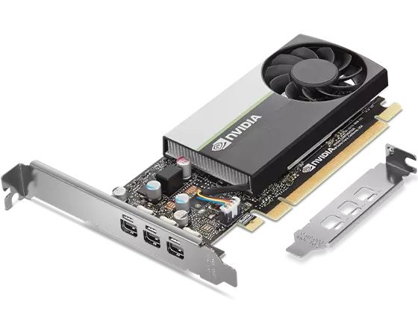
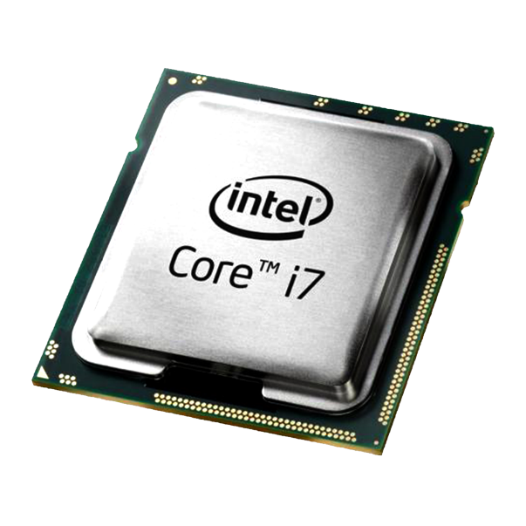
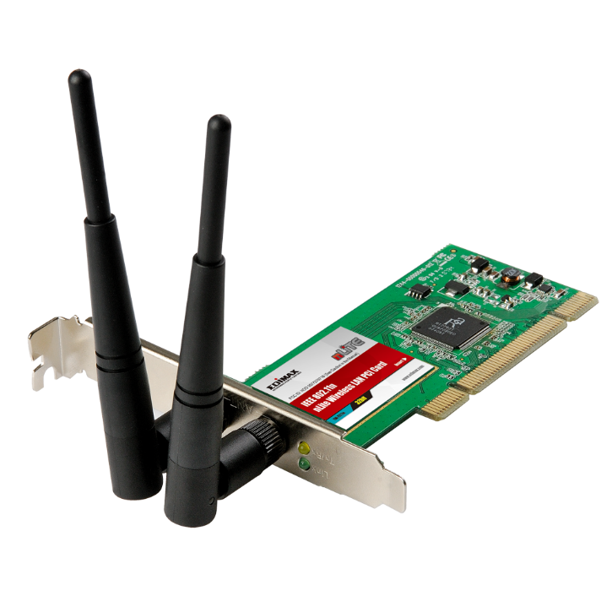
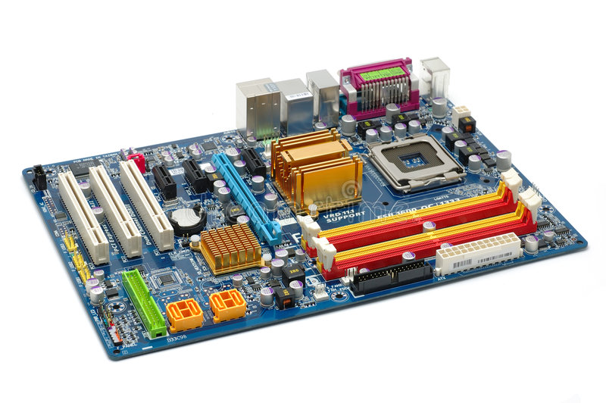
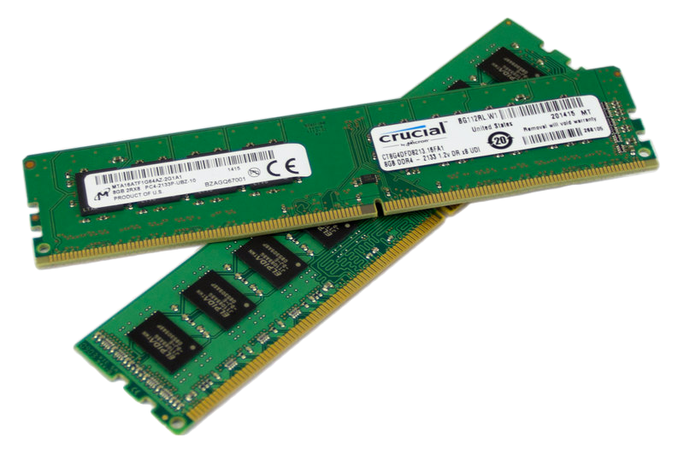
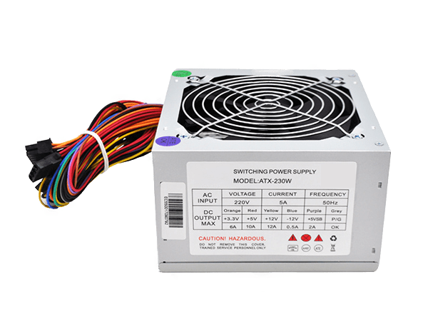
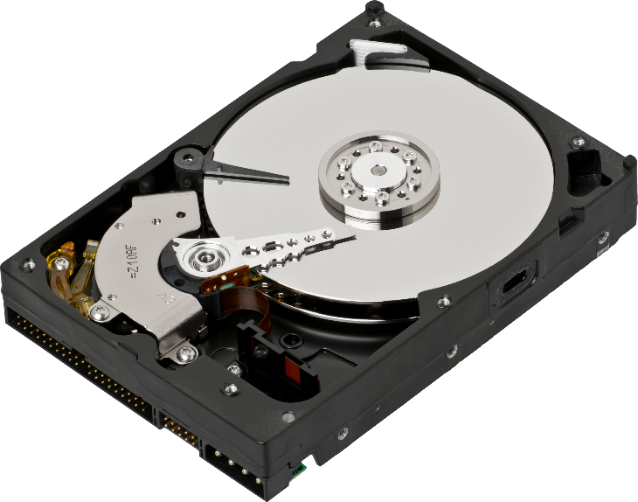
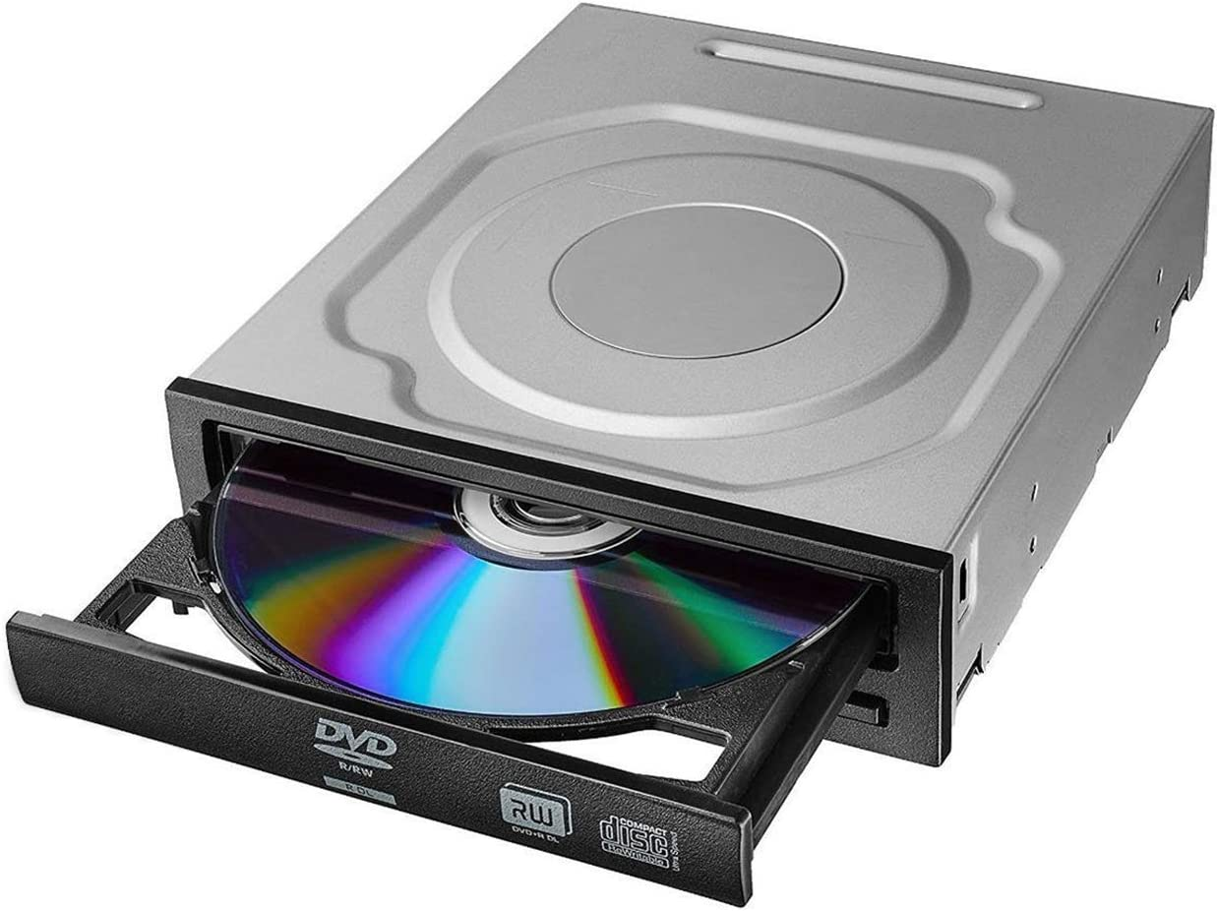
Video/VGA Card
Processor (CPU)
Wireless Card
RAM
Power Supply
Hard Disk
DVD ROM

Slide 10

WATCH & THINK
Watch the video to understand the component of
Motherboard
10 MIN
Notes:
Video 1: https://www.youtube.com/watch?v=HB4I2CgkcCo
Video 2: https://www.youtube.com/watch?v=ExxFxD4OSZ0

Slide 11
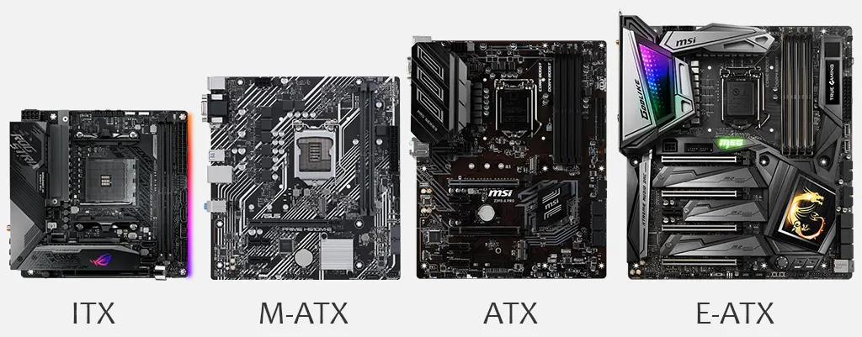
Type of Motherboard
EXPLAIN
10 MIN
(6.7”x6.7”)
(9.6”x9.6”)
(12”x9.6”)
(13”x12”)

Slide 12


QUIZ
Matching Component on Motherboard
10 MIN
Go to this link!
Notes:
Activity #1: https://wordwall.net/en-gb/community/motherboard

Slide 13

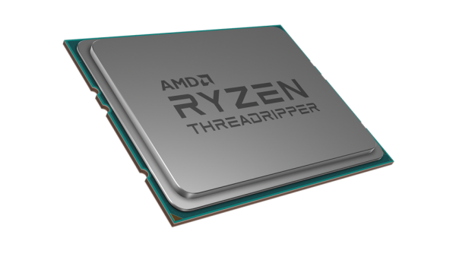
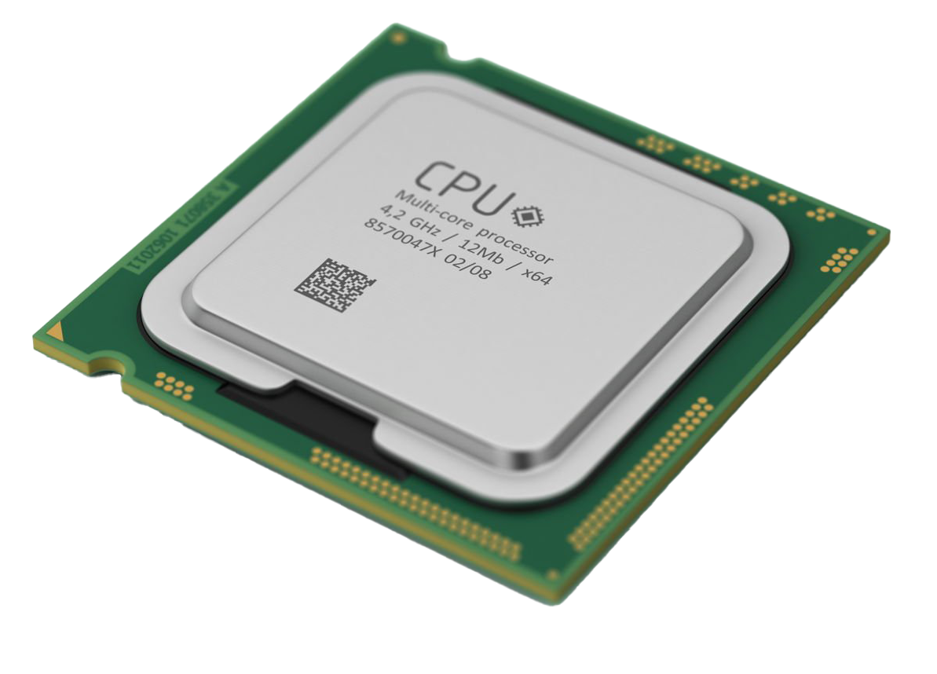
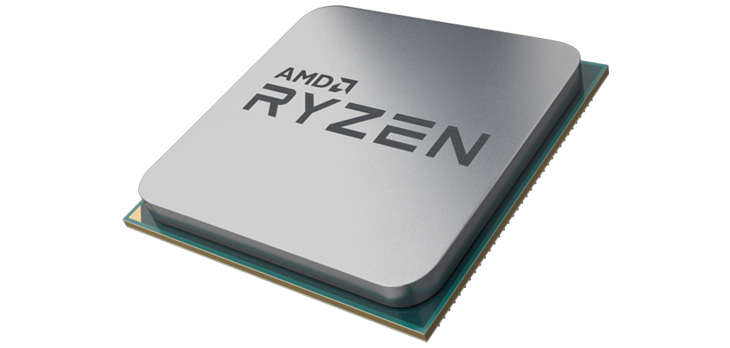
CPU

Slide 14

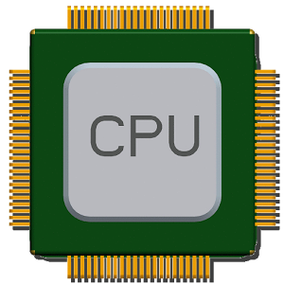

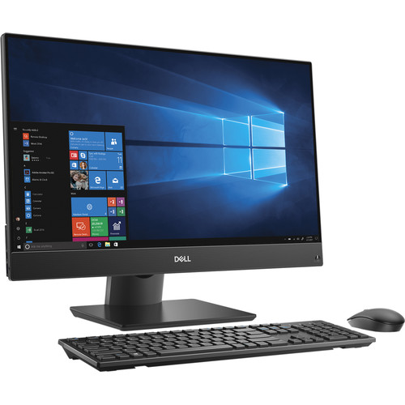

ENGAGE
What is CPU?
2 MIN
Same AS

Slide 15

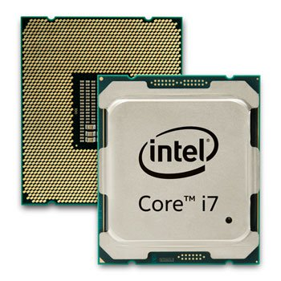
ENGAGE
What Role Of CPU In Computer?
2 MIN
What do you think
CPU dose in Computer?
It does all decisions, calculations all processing in Computer.
Example, even you typing or you move your mouse, all process need CPU make decisions.
Notes:
It does all decisions, calculations all processing in Computer.
Example. Even you typing or you move your mouse, all process need
CPU make decisions.

Slide 16

EXPLAIN
CPU in short
10 MIN
CPU is the “brain”of Computer system
CPU stands for Central Processing Unit
It runs program instructions
Basically the faster the CPU, the faster computer will perform
Notes:
Find one video to let student watch to get understanding more about how CPU work?
https://www.youtube.com/watch?v=DKGZlaPlVLY
https://www.youtube.com/watch?v=lxnlyJYZ6Vw

Slide 17
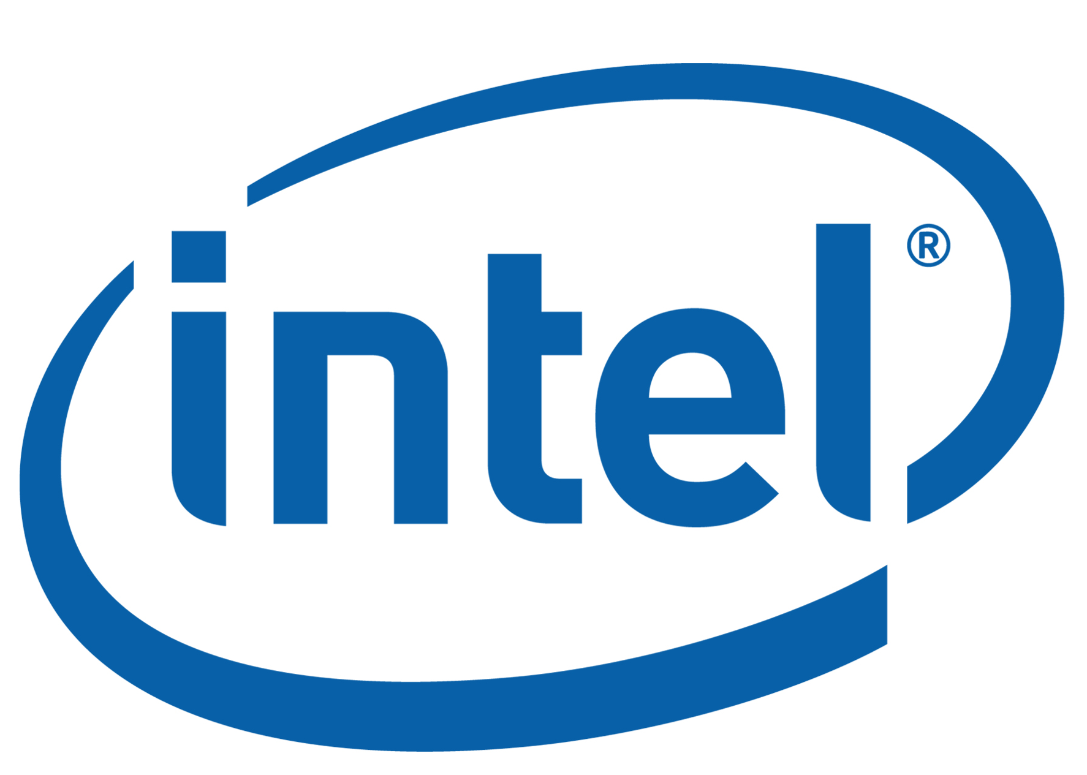


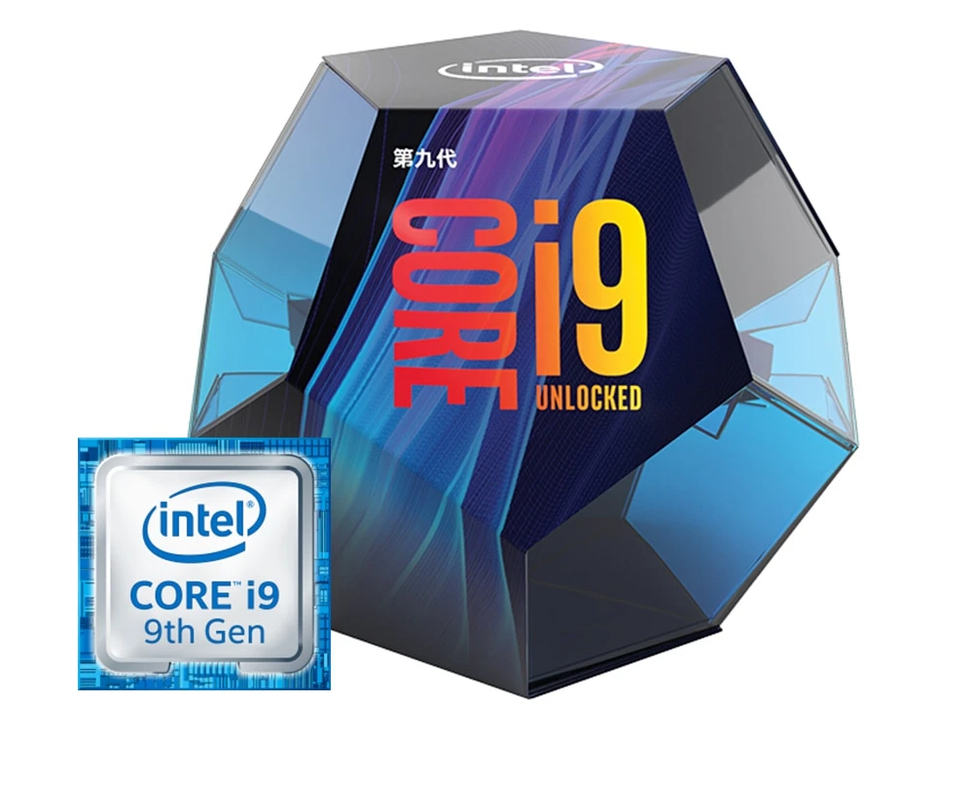
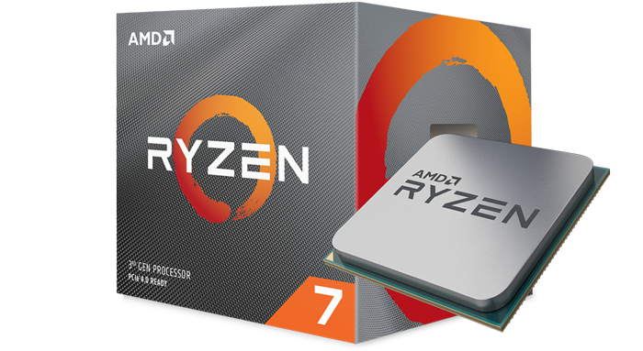
Modern CPUs
Notes:
Check for update CPU version and generation
https://www.amd.com/en/products/processors-desktop (AMD)
https://www.intel.com/content/www/us/en/products/processors.html (Intel)
https://www.youtube.com/watch?v=gMSTXItiNVs (Comparison Intel i7, AMD Ryzen 7)
https://www.theverge.com/2019/8/21/20826446/intel-10th-gen-comet-lake-processors-thunderbolt-wifi-series-announcement (Intel 10th gen)

Slide 18
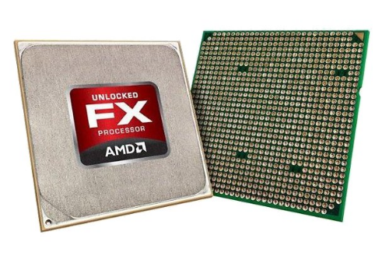
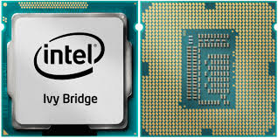
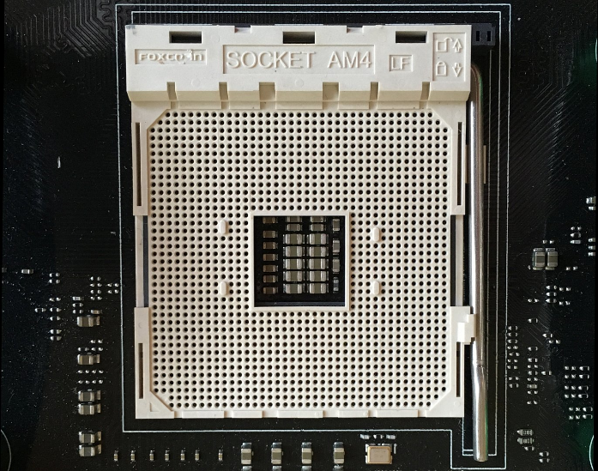
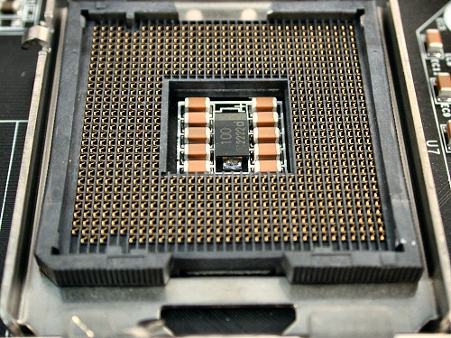
EXPLAIN
CPU and Socket
5 MIN
Manufacturers
Intel
AMD
Intel platform use LGA ( Land grid Array) socket type.
AMD platform use PGA ( Pin grid Array) socket type.
Notes:
Processor socket – determines which processors a board can support
Socket holds Intel or AMD processor
Intel platform of socket use LGA ( Land grid Array) type. AMD platform use PGA ( Pin grid Array) type. Noted: Socket can support both CPU intel and AMD but nowdays they devide AMD use PGA and Intel use LGA https://en.wikipedia.org/wiki/CPU_socket

Slide 19
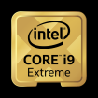
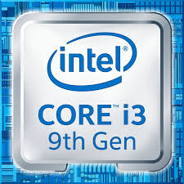
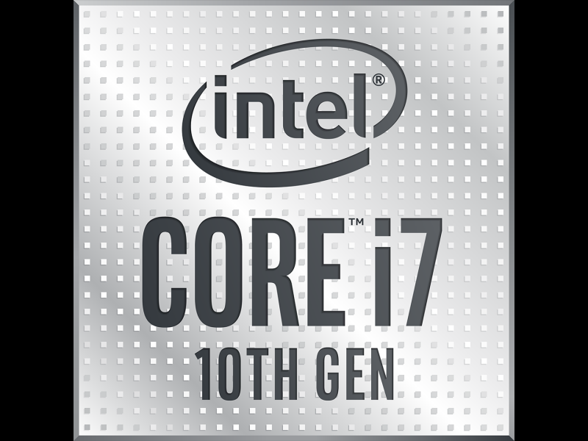
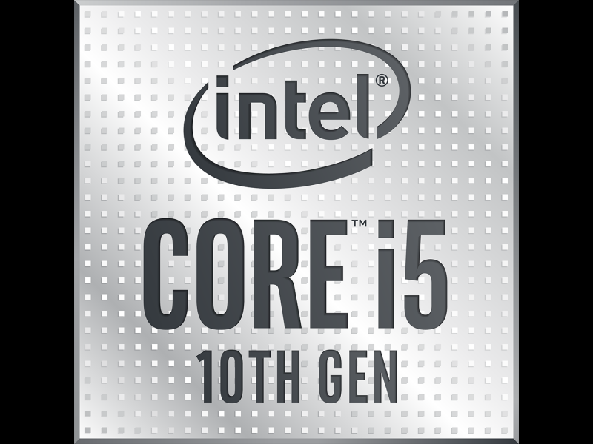
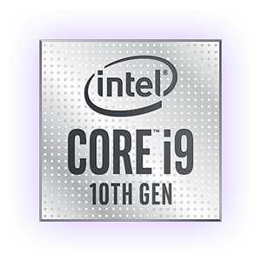

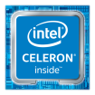
Gaming | Content Creation | Basic Tasks
Intel Core X-Series Processor | Intel Core X-Series Processor | Intel Core i3 Processor
Intel Core i7 Processor | Intel Core i7 Processor | Intel Core i5 Processor
Intel Core i9 Processor | Intel Core i9 Processor | Intel Pentium Processor
 |  | Intel Celeron Processor
Notes:
Check for update CPU version and generation
https://www.amd.com/en/products/processors-desktop (AMD)
https://www.intel.com/content/www/us/en/products/processors.html (Intel)
https://www.youtube.com/watch?v=gMSTXItiNVs (Comparison Intel i7, AMD Ryzen 7)
https://www.theverge.com/2019/8/21/20826446/intel-10th-gen-comet-lake-processors-thunderbolt-wifi-series-announcement (Intel 10th gen)

Slide 20
EXPLAIN
Technology on Cpu
10 MIN
64-bit processing
Clock speed
CPU Cores
Virtualization support
Integrated graphics processing unit (GPU)
Notes:
64 bit means CPU transfer data 64 bit per time, in 1 second CPU can process two thousand million times
Clock speed is related to 64 bit which means it compare the transformation of CPU as a time.
CPU cores it refer to we multi processing which means if you use CPU that has 2 core the process for each time will x 2 ….
Virtualization support is referred to the function of the CPU that allows the user to run multi OS once at a time.
GPU integration is referred to some CPUs that include GPU inside which means it will help the CPU to process the graphic faster than before. So, it can be reduce the CPU work on graphic

Slide 21

Selecting CPU
What’s information you need to check before select CPU
Check motherboard Manufacturers
Go To Manufacturers Websites
Check spec and CPU support
Notes:
Manufacturers: is the company the produce the the products. Example CPU, Motherboard.
There are many manufacturers companies that create CPU. But the most company is AMD and Intel.

